Slide 1
Olaniyi Bayonle Alao
2180561
WinterSemester 2019/20

Slide 2
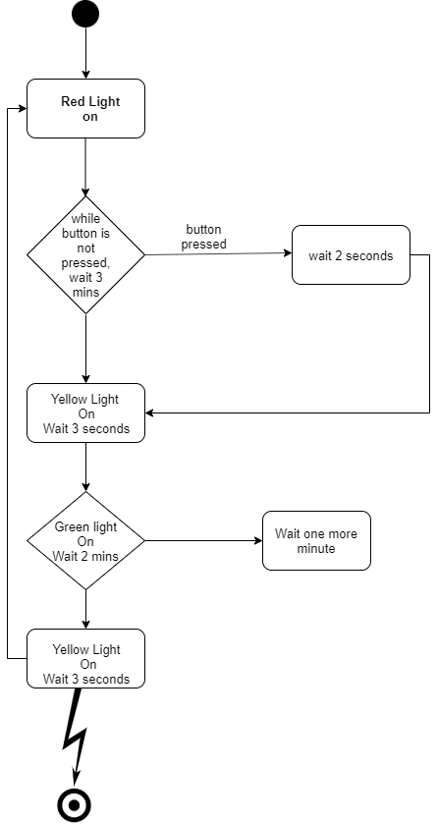
Activity Diagram

Slide 3
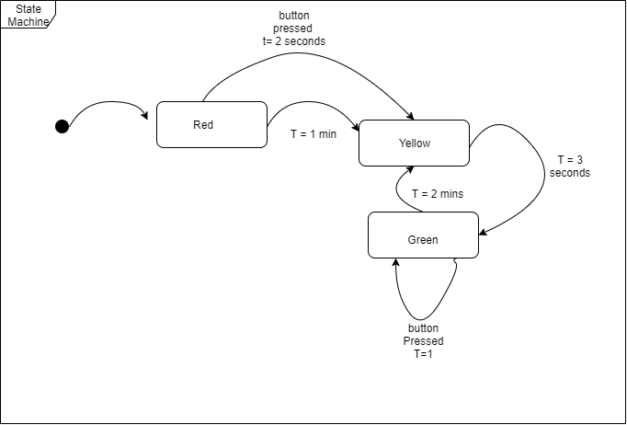
State Machine Diagram

Slide 4
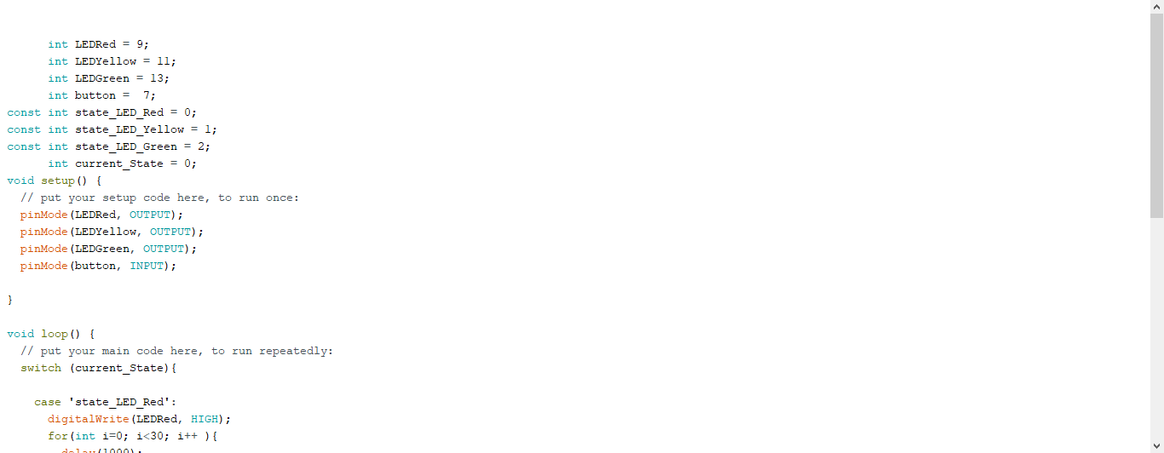
Lines Of Code

Slide 5
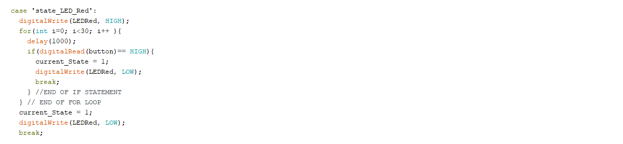
Lines Of Code

Slide 6
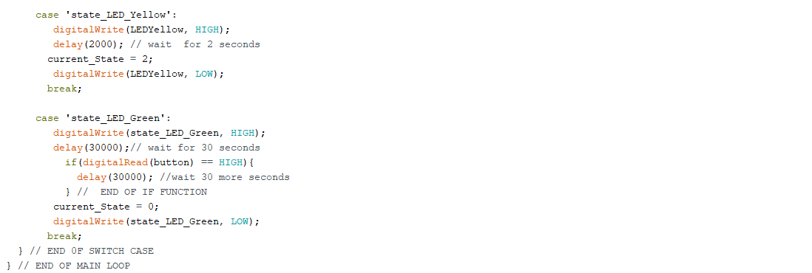
Lines Of Code

